Slide 1


MOBILE PRICE PREDICTION

Slide 2




Team 3
Mamatha Thippani
Mamatha Peddamala
Koteswar Enamadni
Teja Reddy Soma

Slide 3

INTRODUCTION
Mobile price prediction using python is an application that leverages the power of data to estimate the price of a Mobile phone based on various attributes. This can be immensely helpful for both consumers and businesses alike. For consumers, it aids them in making informed purchasing decisions by assessing whether a given mobile phone's price is justified by its specifications. Business entities, particularly those in the Mobile phone industry, can make use of it to guide pricing strategies and position themselves in the market.

Slide 4

Challenge
What is the expected price range for a given mobile phone model based on its specifications?

Slide 5
SOLUTION
Data analysis and machine learning can be used to calculate the projected price range for a certain mobile phone model based on its specs. A predictive model can forecast a price range with upper and lower boundaries by examining historical data of different mobile phone models and their corresponding characteristics and costs. Businesses and consumers can use this information to make educated decisions about pricing and mobile phone purchases. It is imperative to take into account that the ultimate cost may be influenced by real-world market conditions and elements such as brand repute.

Slide 6
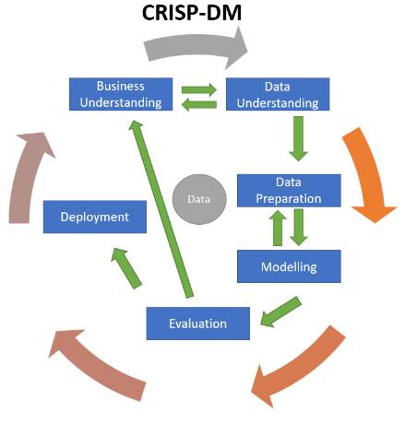
USER STORY
User Story
As a User, I should be able to get a new mobile that meets all my requirements
Sub Goal
take in the specifications of the customer and process them to find the solution that meets all or maximum of the specifications
Main Goal
To suggest a mobile to the customer
Business Goal
Product

Slide 7
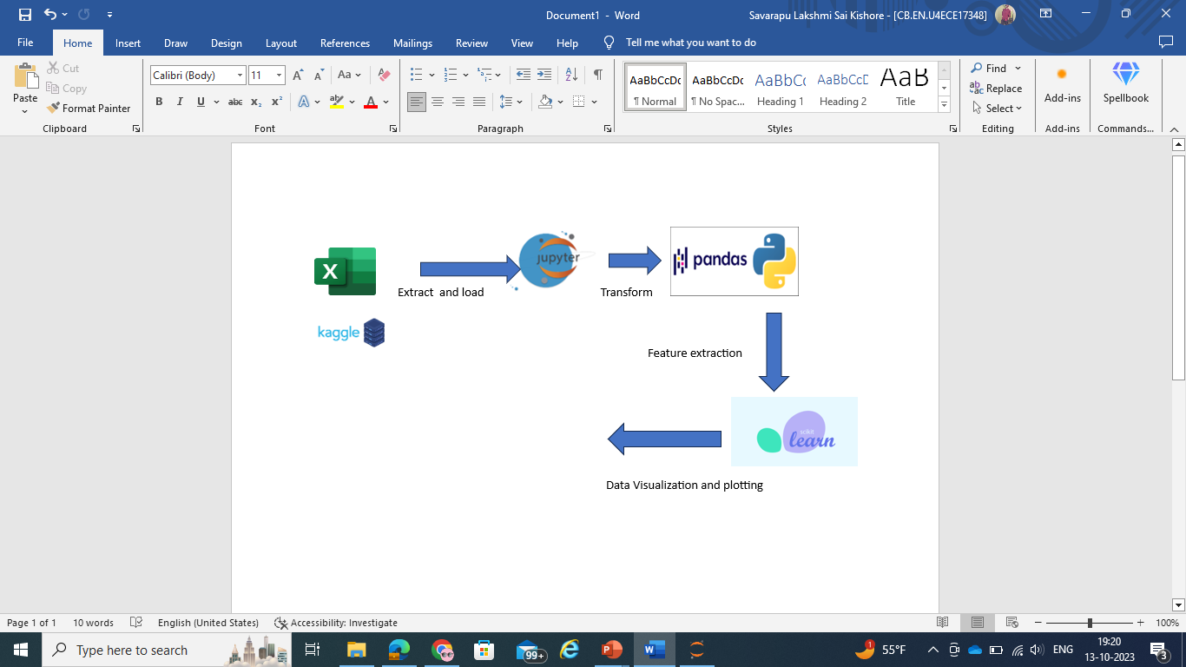
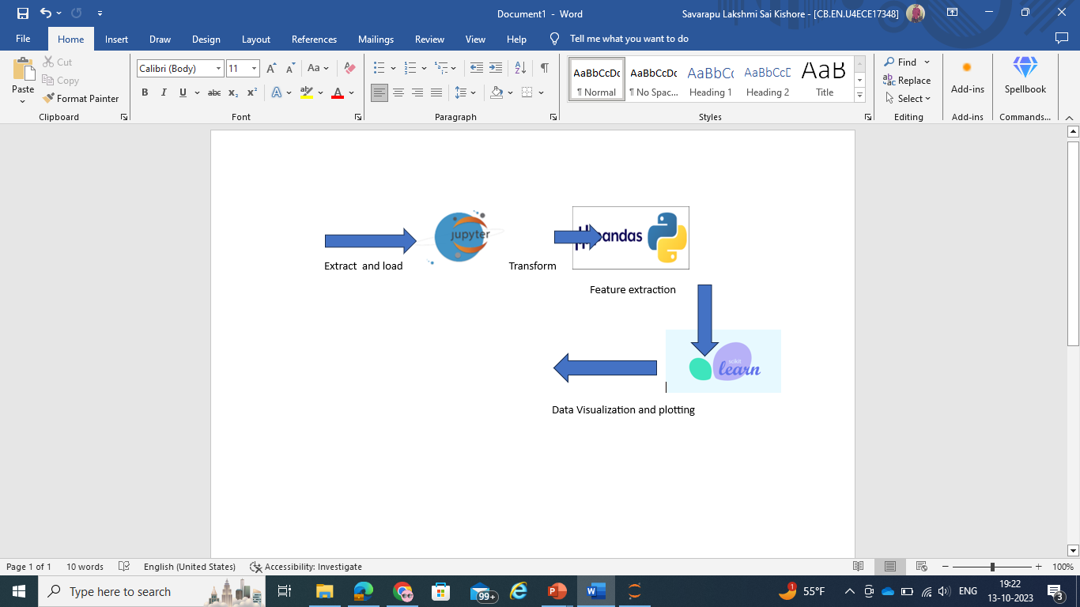

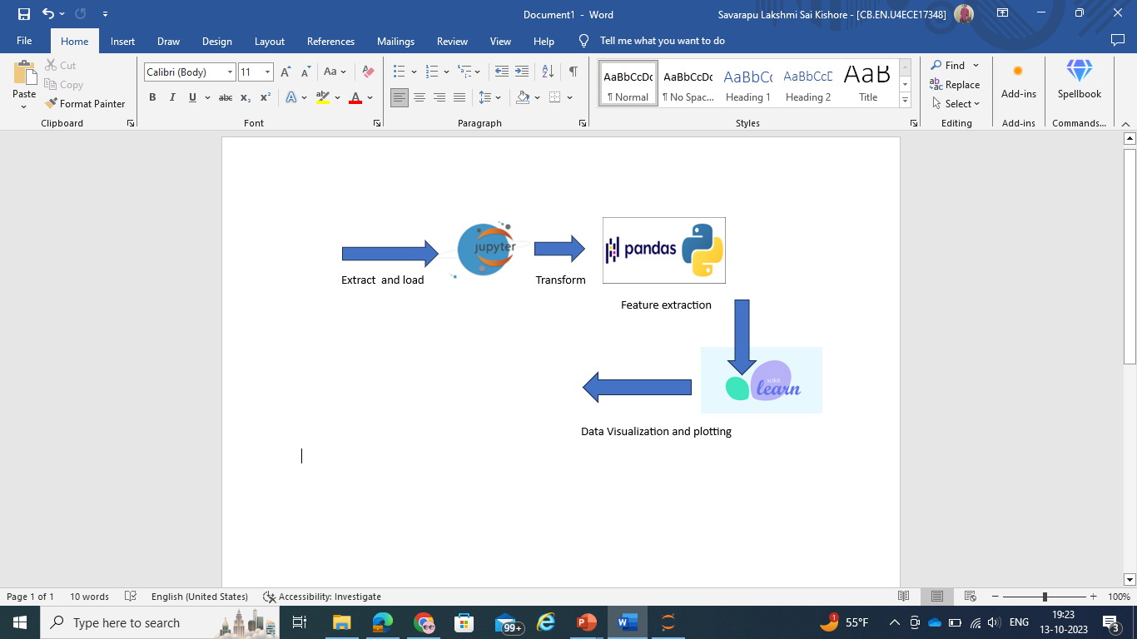
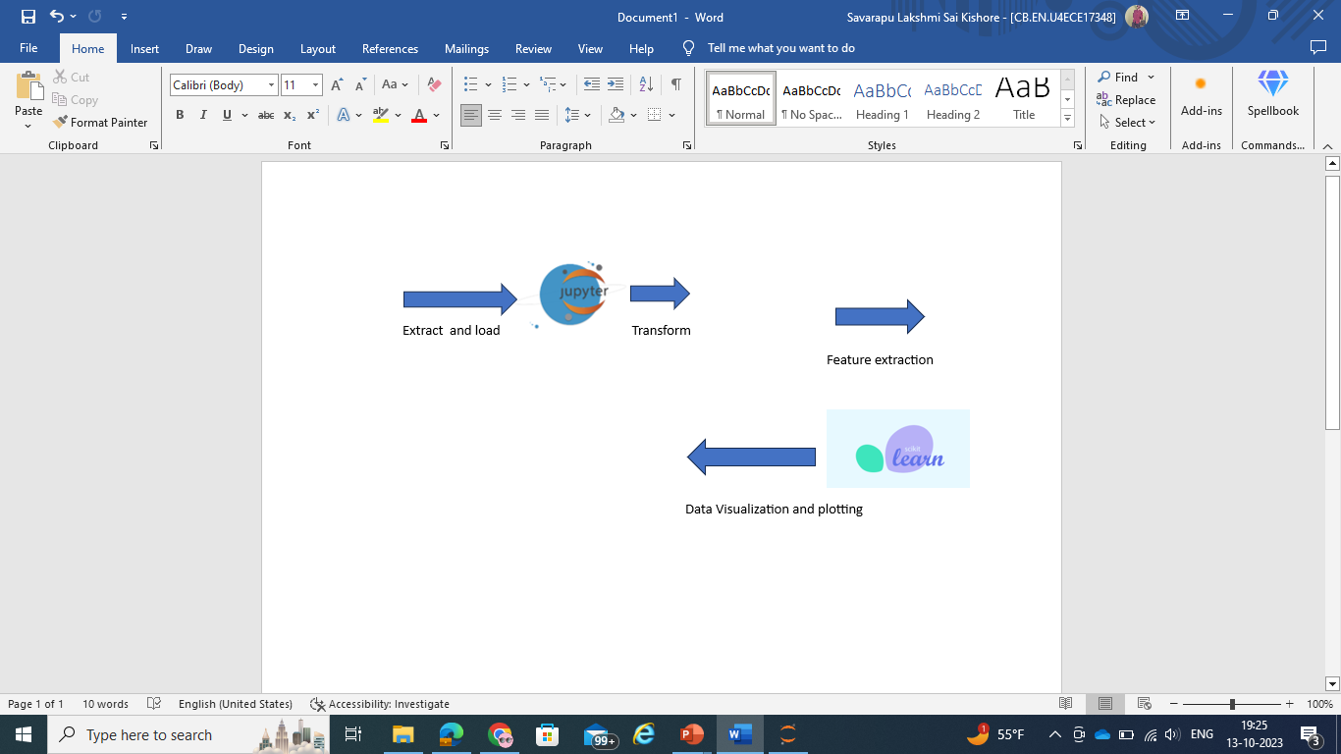

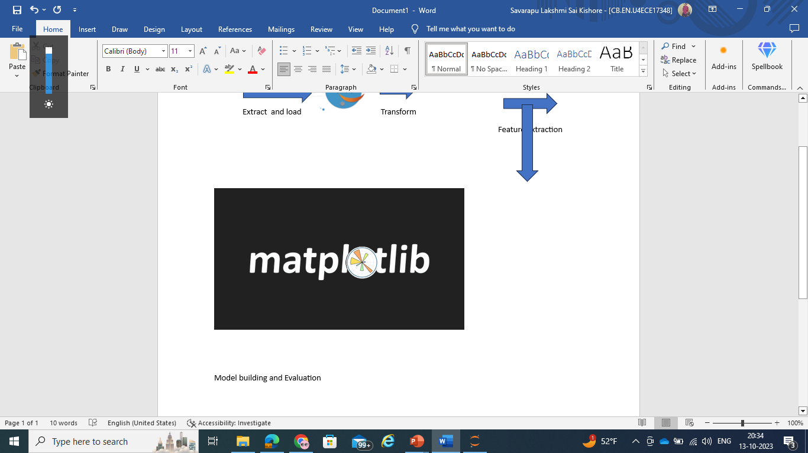
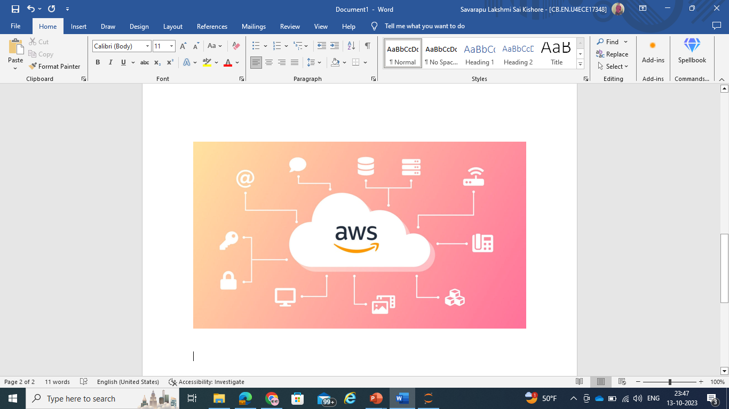
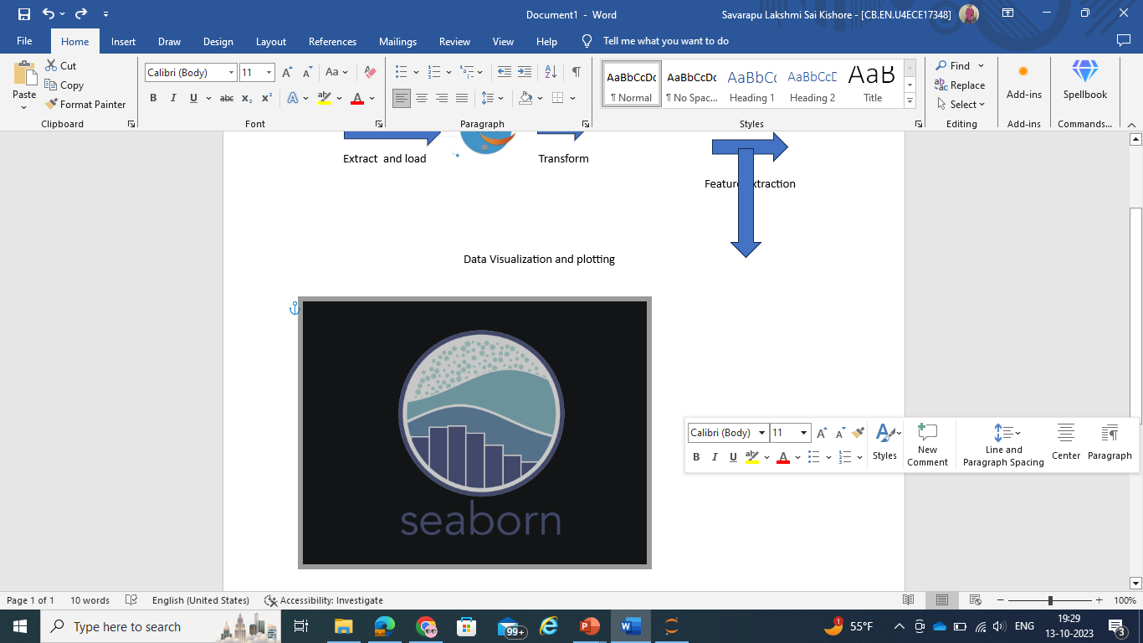
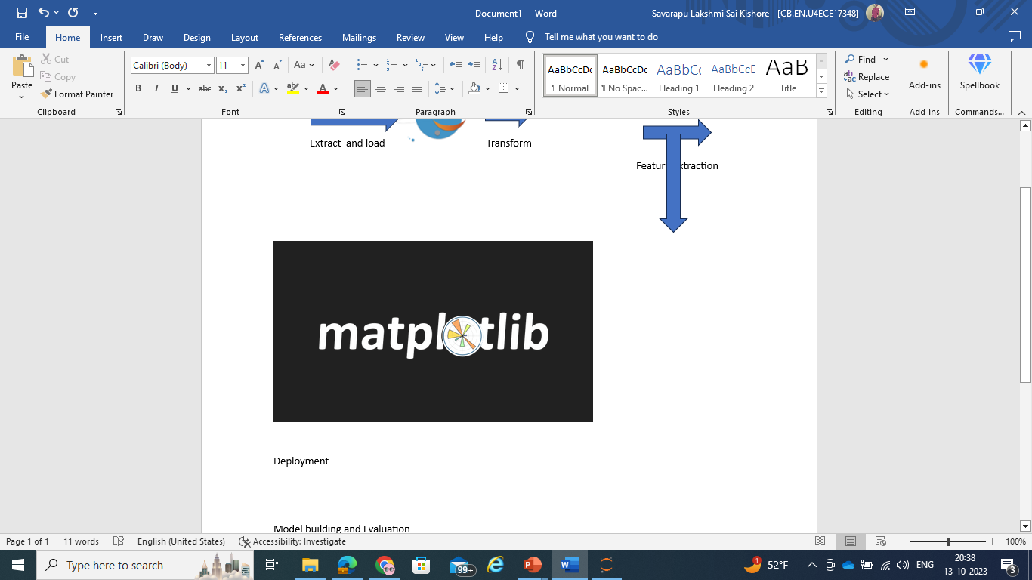
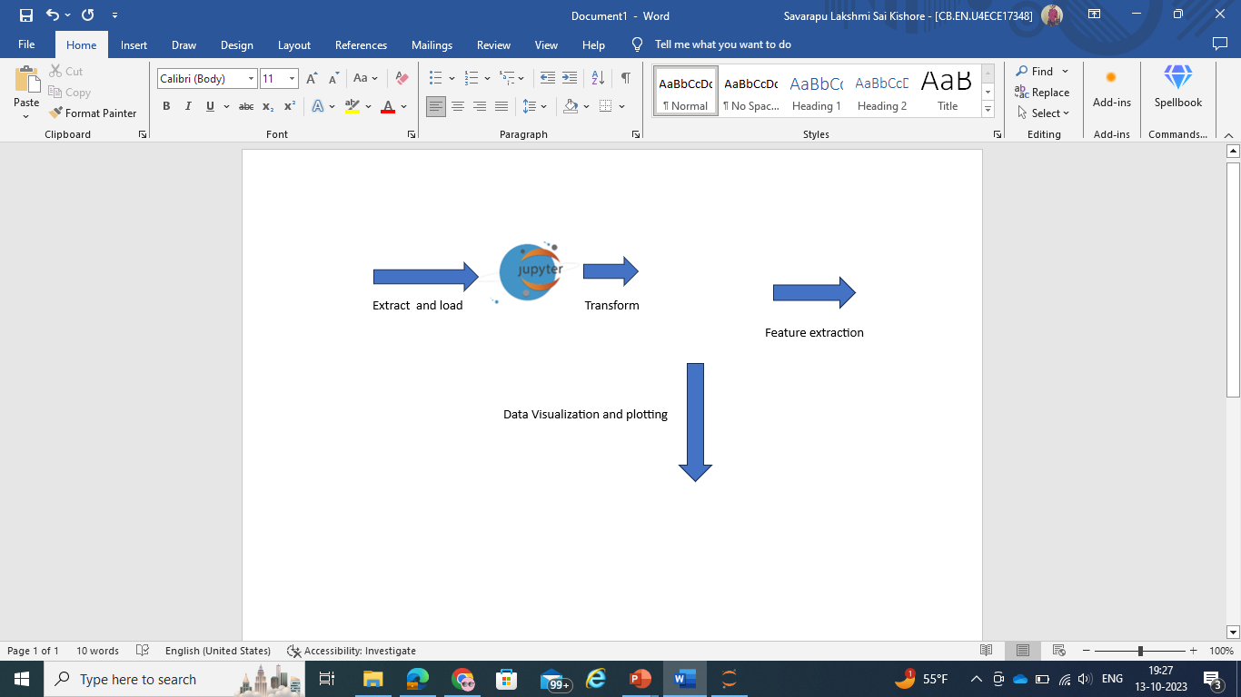
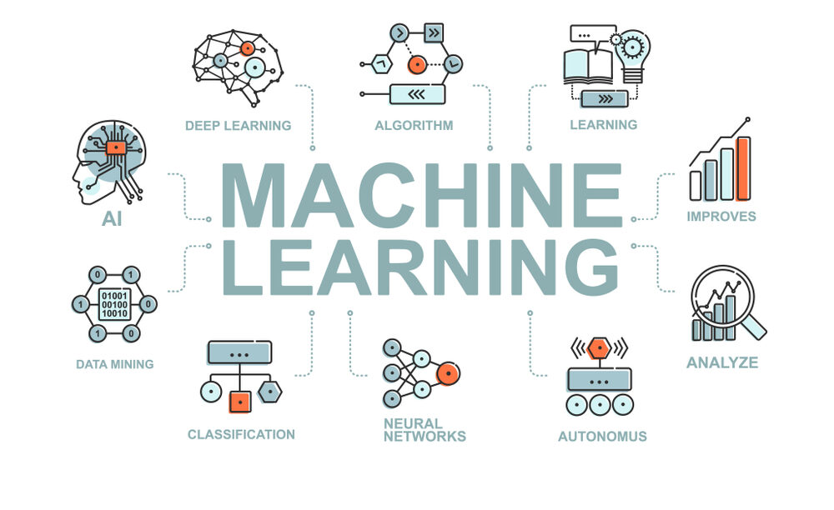

GRAPHICAL VIEW OF THE Proposed MODEL

Slide 8
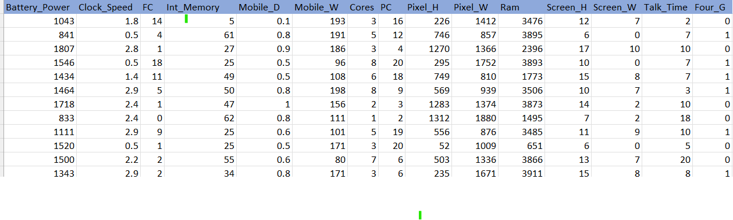
Dataset from Kaggle
https://www.kaggle.com/datasets/fhabibimoghaddam/mobile-price-prediction
Volume: 2000 samples of data
Variety: Structured Data
Velocity: Data collected during 2021
Veracity: Kaggle is said to be the trusted go to point of information
Value: Data can be used to estimate mobile prices

Slide 9
Tools to be used
Data Storage : Data is gathered from Kaggle and saved in a Github account for team members to use and access.
Data Ingestion: Next, data is absorbed into a Jupyter notebook running Python.
Data processing involves importing Python libraries such as numpy, matplotlib, sklearn, pandas, and seaborn to do pre-processing, data purification, and feature extraction.
Using the dataset, machine learning models are constructed and assessed.
Data Consumption: For the benefit of data scientists, analysts, and end users, the model and dataset are kept on Github and AWS.
The user's web application is hosted on Amazon Web Services.

Slide 10
MODELS TO BE USED
To guarantee flawless execution, a data engineering pipeline is used throughout the entire process.
To make sure the appropriate set of data is gathered for the problem statement, the five Vs of data are examined.
Data preprocessing is done to make sure the data is free of bias, noise, and outliers.
To make categorical variables and non-numeric values understandable to the machine learning model, feature extraction is done.
The dataset is used to create Random Forest Regressor and Linear Regression models.
Errors and accuracy are calculated to assess models.
Successful model deployment occurs.

Slide 11
References
https://www.youtube.com/watch?v=mLz_Q7L95C8
https://www.youtube.com/watch?v=rROyz_hZjKQ
https://www.youtube.com/watch?v=880YXMnTeu4
Git Link : View 1 · Intro To DS_Team-3 (github.com)

Slide 12


Slide 13
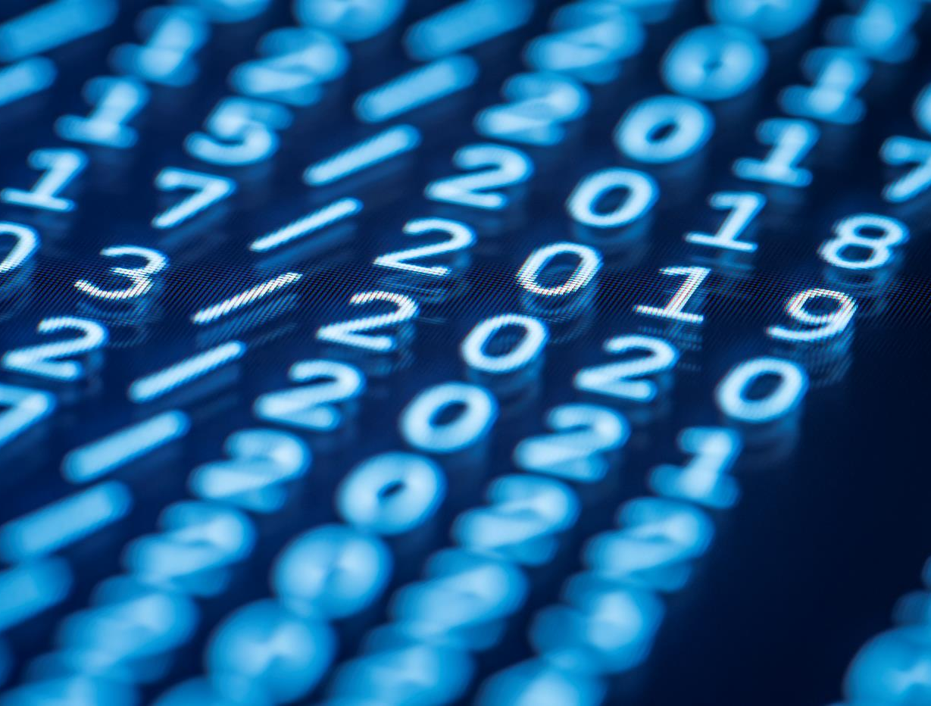
Thank You

